Slide 1
Using social media data to enhance predictive models in finance
Nicholas Mitchell
Munich, September 2016

Slide 2
We aimed to answer the question(s):
We aimed to answer the question:
Can social media data improve predictive models of financial markets?
…by how much?

Slide 3
The Roadmap
Obtain social media data
→ Twitter scraping
Perform NLP on every tweet
→ sentiment analysis
Predictive modelling
→ gradient boosting
Market data
Notes:
Take a minute to explain this slide in simple terms – the “Sales pitch”

Slide 4



Tapping the Twitterverse
Purchase them
Every tweet since Twitter inception
Enterprise solution
Expensive
Official API
Free
Fast
Limited to last 10 days of data
Unofficial API… Scraping
Free
(currently) slow
(currently) unlimited data*

Slide 5

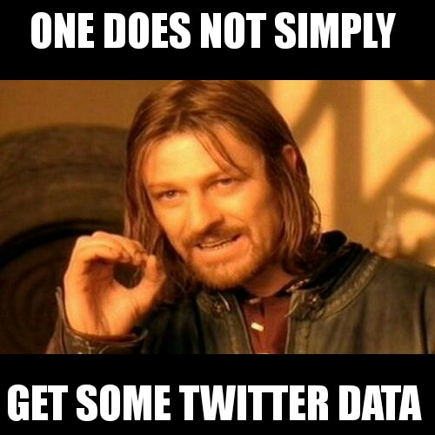
Scraping
Twitter’s advanced search:
Choose a search term
Select a date range
Tweets are displayed
Page loads - starting with youngest tweets
Scroll downwards → backwards in time
Dynamically loading page
Save all HTML code from Browser – WYSINAYG!

Slide 6
Parsing
Take raw HTML → parse using Xpath-Element-trees
Create a one-tweet-per-line CSV file
In addition to tweet text, extract useful meta-data:
Date
Number of likes
Number of retweets
Unique tweet ID
Username & ID
Geo-coordinates
Number of search terms: 13
Date range: 14.01.2013 – 11.09.2015
Total timeline: 982 days (695 weekdays)
Total tweets obtained: 2, 350, 217

Slide 7

Cleaning the tweets
Genuine tweet
Required to facilitate accurate sentiment analysis
Tweets had to go from:
“““I wonder what people think about the Dow Jones Industrial Average ““Death Cross““ now? :)^M #trendfollowing pic.twitter.com/nnyXLMlShA^M“““
To this:
I wonder what people think about the Dow Jones Industrial Average Death Cross now? :) trendfollowing
→ RegEx using Perl engine → hexadecimal char definitions → using an ASCII table

Slide 8
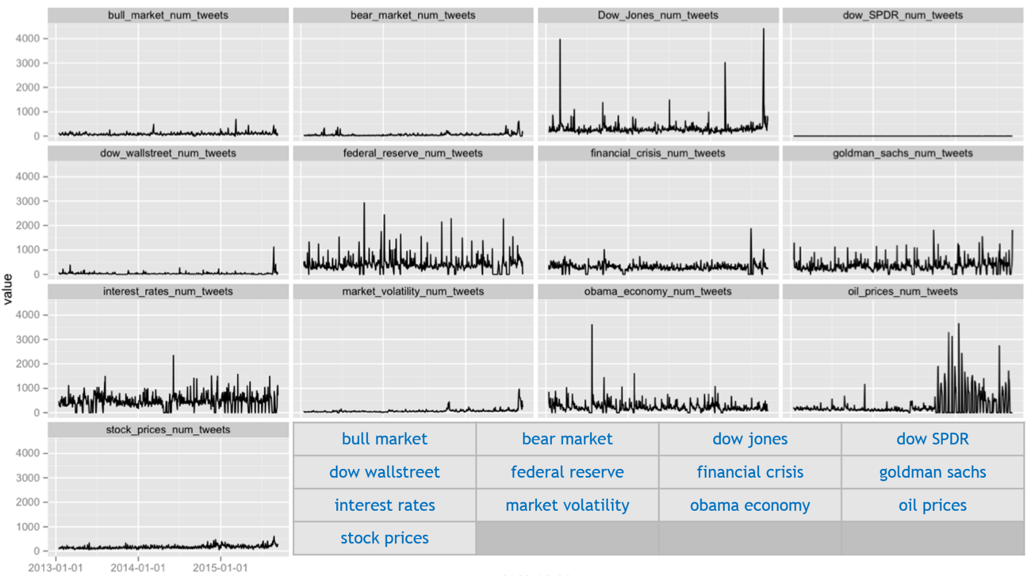
Breakdown of search terms and tweet count
bull market | bear market | dow jones | dow SPDR
dow wallstreet | federal reserve | financial crisis | goldman sachs
interest rates | market volatility | obama economy | oil prices
stock prices

Slide 9
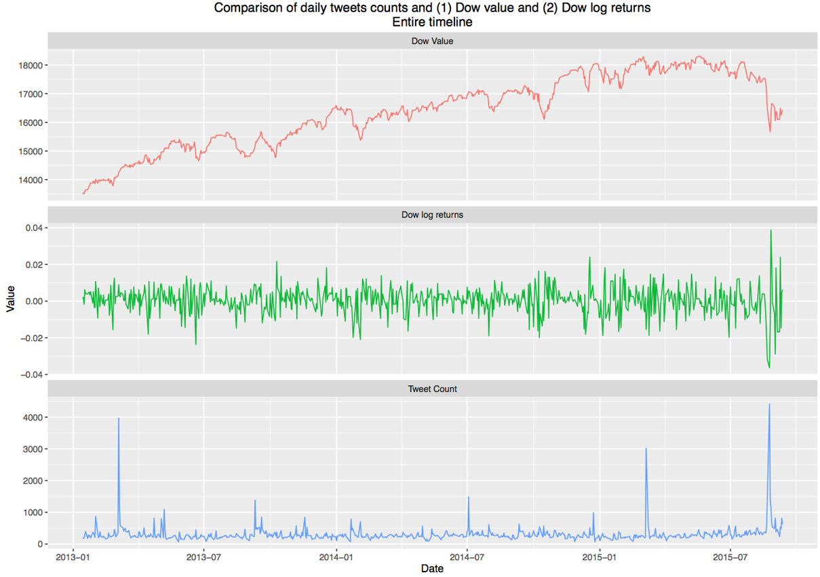
Inspecting the Twitter data (1)
Notes:
Can we see how the spikes in social media data help us understand the impact of market events, and if they improve predictions?

Slide 10

The Roadmap
Obtain social media data
→ Twitter scraping
Perform NLP on every tweet
→ sentiment analysis
Predictive modelling
→ gradient boosting
Market data

Slide 11
Sentiment Analysis (1)
5 differing models
Each focussed on short texts / social media data
Employ diverse linguistic approaches
Example approaches:
Grammar based – scored word lists for nouns, verbs, adjectives, etc.
Informal text – scores for smileys, slang and profanity
Pure word list, create by a community/mechanical Turk
example: Plutchik‘s Wheel of Emotion

Slide 12
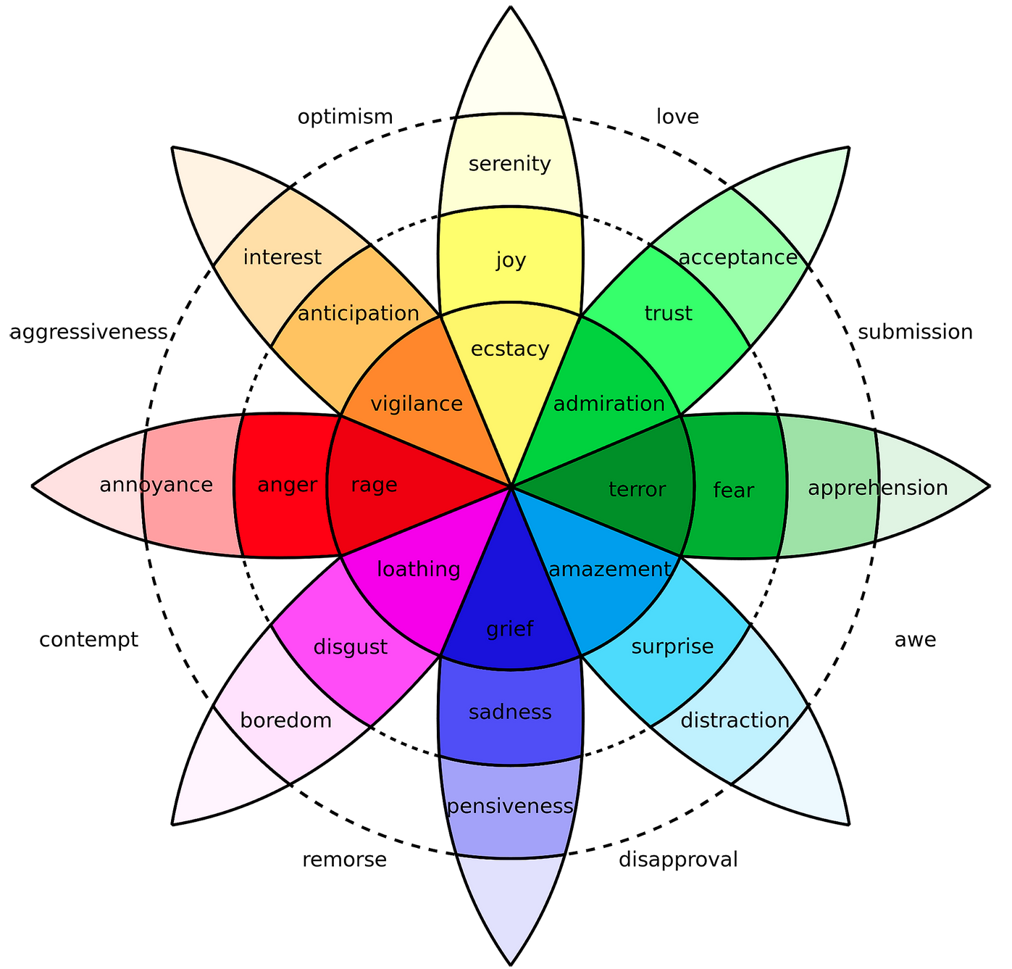
Intensity of colour ≈ intensity of emotion

Slide 13

Sentiment Analysis (2)
Basic example: score each word on two dimensions:
positivity
love
love-hate?
singing
falling
hate
negativity
Example:
Rupert loves safe investments, but Niko loves risky OTM options
(1,1) (4,1) (3,2) (1,1) (1,1) (1,1) (4,1) (1,3) (1,1) (2,1)
∑ = (19, 13)
Notes:
All models produce results on their own scales. Sometimes more than one result is produced → positive and negative.
Love-Hate can therefore be quantified.
All these results were centred around zero and normalised, which helps the model make better comparisons (having variables in similar orders of magnitude), plus it also helps the numerical stability of the algorithm.

Slide 14
The Roadmap
Obtain social media data
→ Twitter scraping
Perform NLP on every tweet
→ sentiment analysis
Predictive modelling
→ gradient boosting
Market data

Slide 15
Market data
Commodities | Currency pairs | Fixed income
Gold spot Gold 3M Copper spot Copper 3M Oil (WTI) Natural gas | USD-AUD USD-CAD USD-EUR USD-GBP USD-JPY | U.S. Zero-coupon 1Y U.S. Zero-coupon 2Y U.S. Zero-coupon 5Y U.S. Zero-coupon 10Y U.S. Zero-coupon 15Y U.S. Zero-coupon 20Y
Indices | Volatility indicators | ETF
DAX Dow Jones FTSE100 Nikkei 225 S&P500 Shanghai SE | VIX (S&P500) Gold spread Copper spread | MSCI Emerging Markets

Slide 16
Datasets for comparison
∑
traditional_{small} 6
traditional_{large} 36
Traditional market data
Small selection
Everything
Sentiment data only
Aggregated
Individual
sentiment_{small} 22
sentiment_{large} 100
combined 142
Market + social media data
→ “Correlation cut-off” used, reducing datasets for final model

Slide 17

The Roadmap
Obtain social media data
→ Twitter scraping
Perform NLP on every tweet
→ sentiment analysis
Predictive modelling
→ gradient boosting
Market data

Slide 18
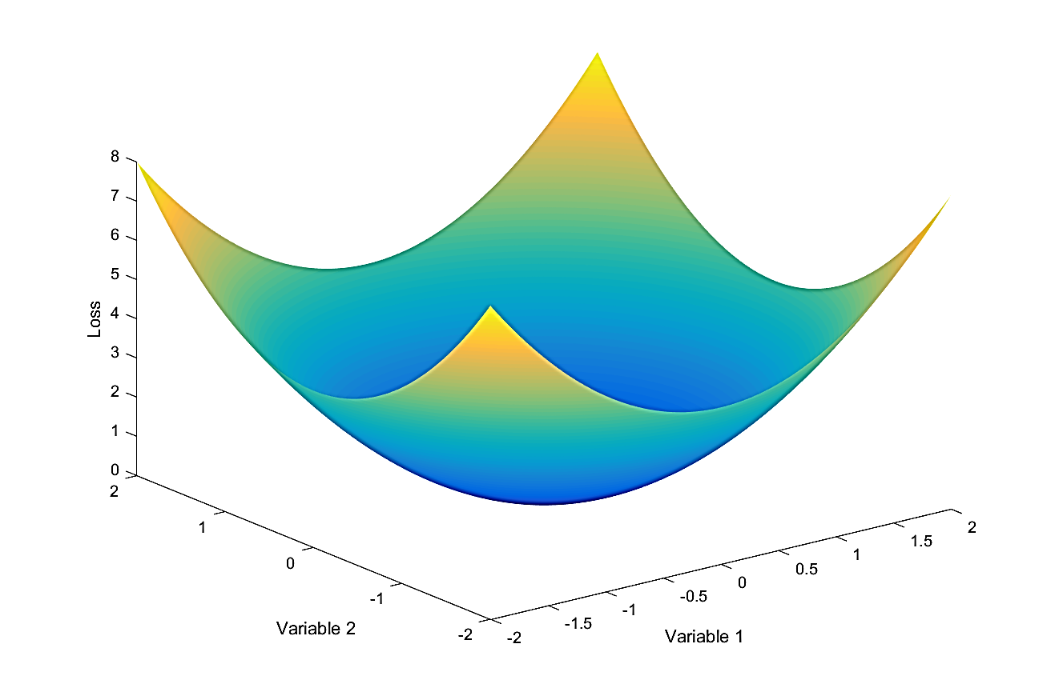
Modelling: Gradient Boosting
Define a Loss function → measure error
cost function (NN), hinge loss (SVM)
Convex → minimisation
Continuous → calculate gradient
Boosting “iteratively, down” the gradient
Fit some model to data
Measure error of fit
Update model based on error
Repeat!
…. Until at bottom of the bowl

Slide 19
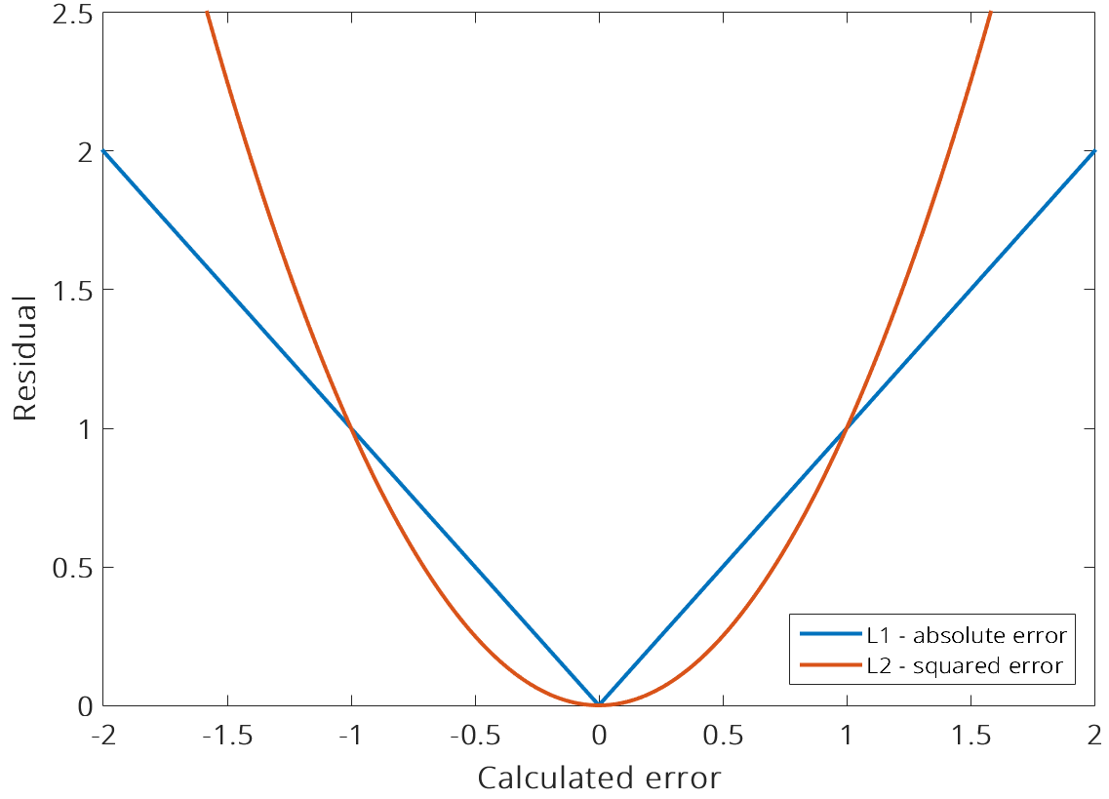
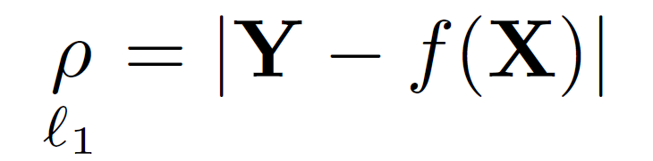
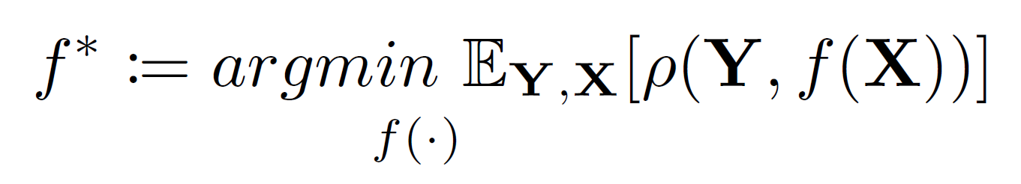
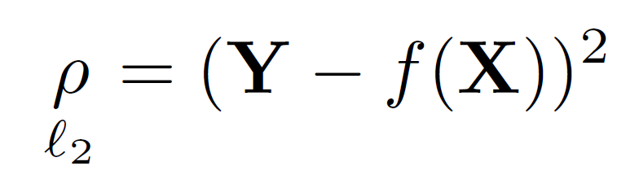
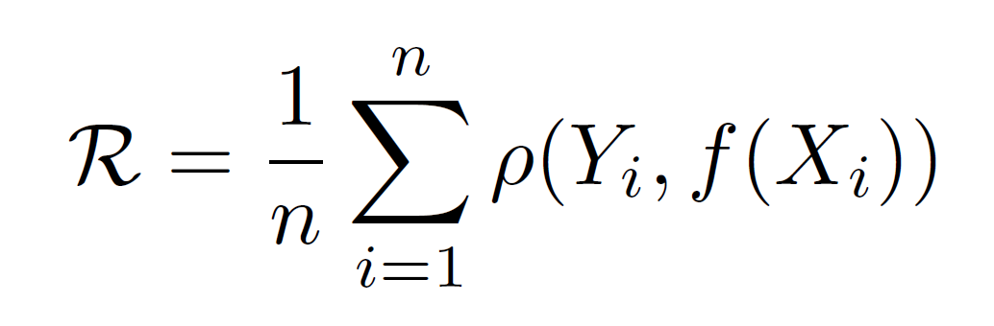
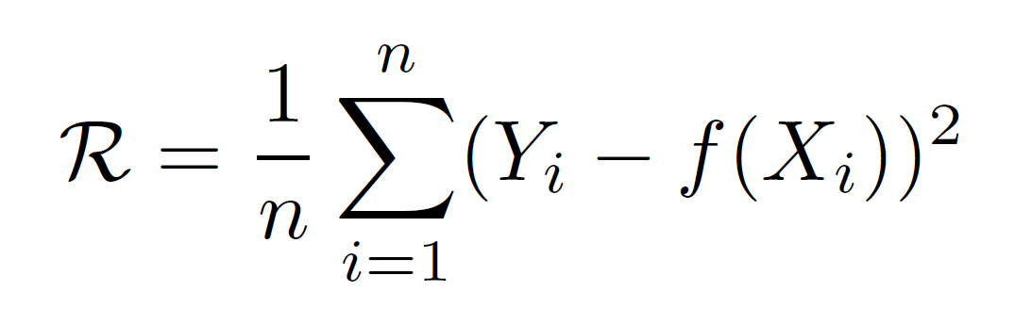
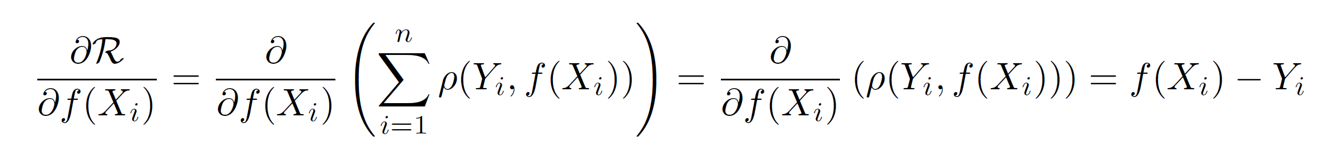
Gradient Boosting: theory in a nutshell
Notes:
Explain two loss function examples – consist of our target Y, and our function on the data f(x)
describe our ‘bowl’ with these two functions → cross section → L1 is less forgiving of outliers
From left to right: explain optimisation function – minimise our loss/approximation error through changing our approximation function.
We choose L2
Want to minimise the empirical risk (observed mean error), error across all measurements
Insert L2 loss function into it
Find the gradient
Re-arrange to get negative gradient → multiply by -1
Explanation of the derivative being scaled by a half:
http://projecteuclid.org/download/pdfview_1/euclid.ss/1207580163

Slide 20
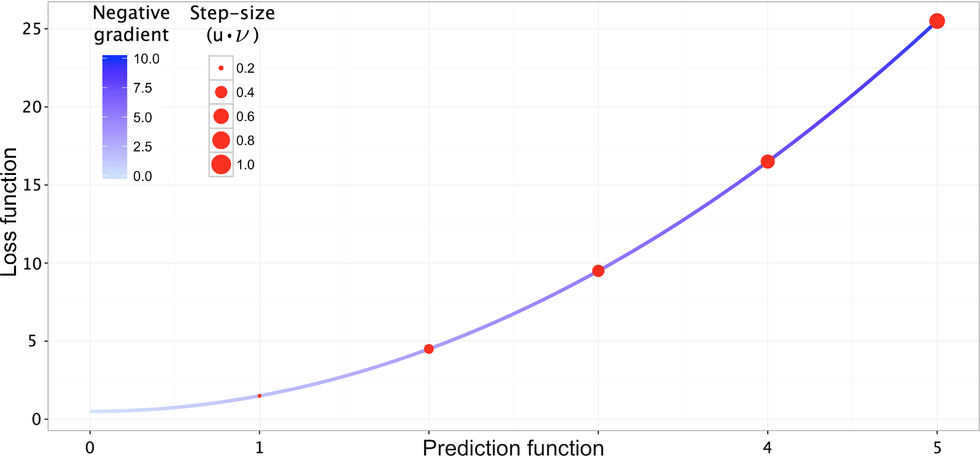
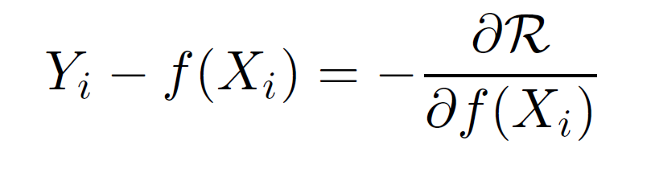
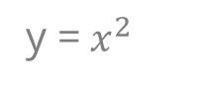
Adaptive descent
y =$x^{2}$
Notes:
Key message: at higher gradients, we update our approximation function more drastically as we have a high reduction in error, therefore far from global minima (smooth and convex!)

Slide 21
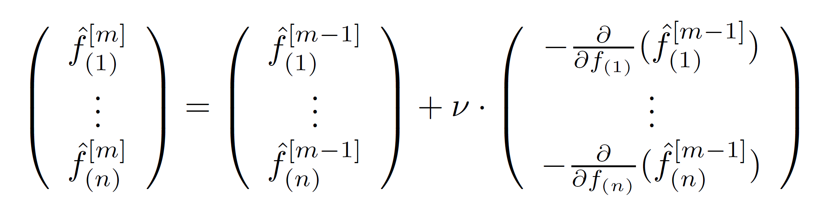


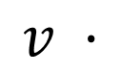

Iteratively improving our estimation
$$m$$
Iteration counter:
Learning rate:
$$v$$
$$n$$
Total base-learners:
=
+
$$v ·$$
Notes:
Explain learning rate…. Draw on board a profile view of the loss function bowl. Arrows down the function, if small then we should eventually converge, with enough steps. If too large then we will always overshoot the global minimum and possibly also diverge!

Slide 22
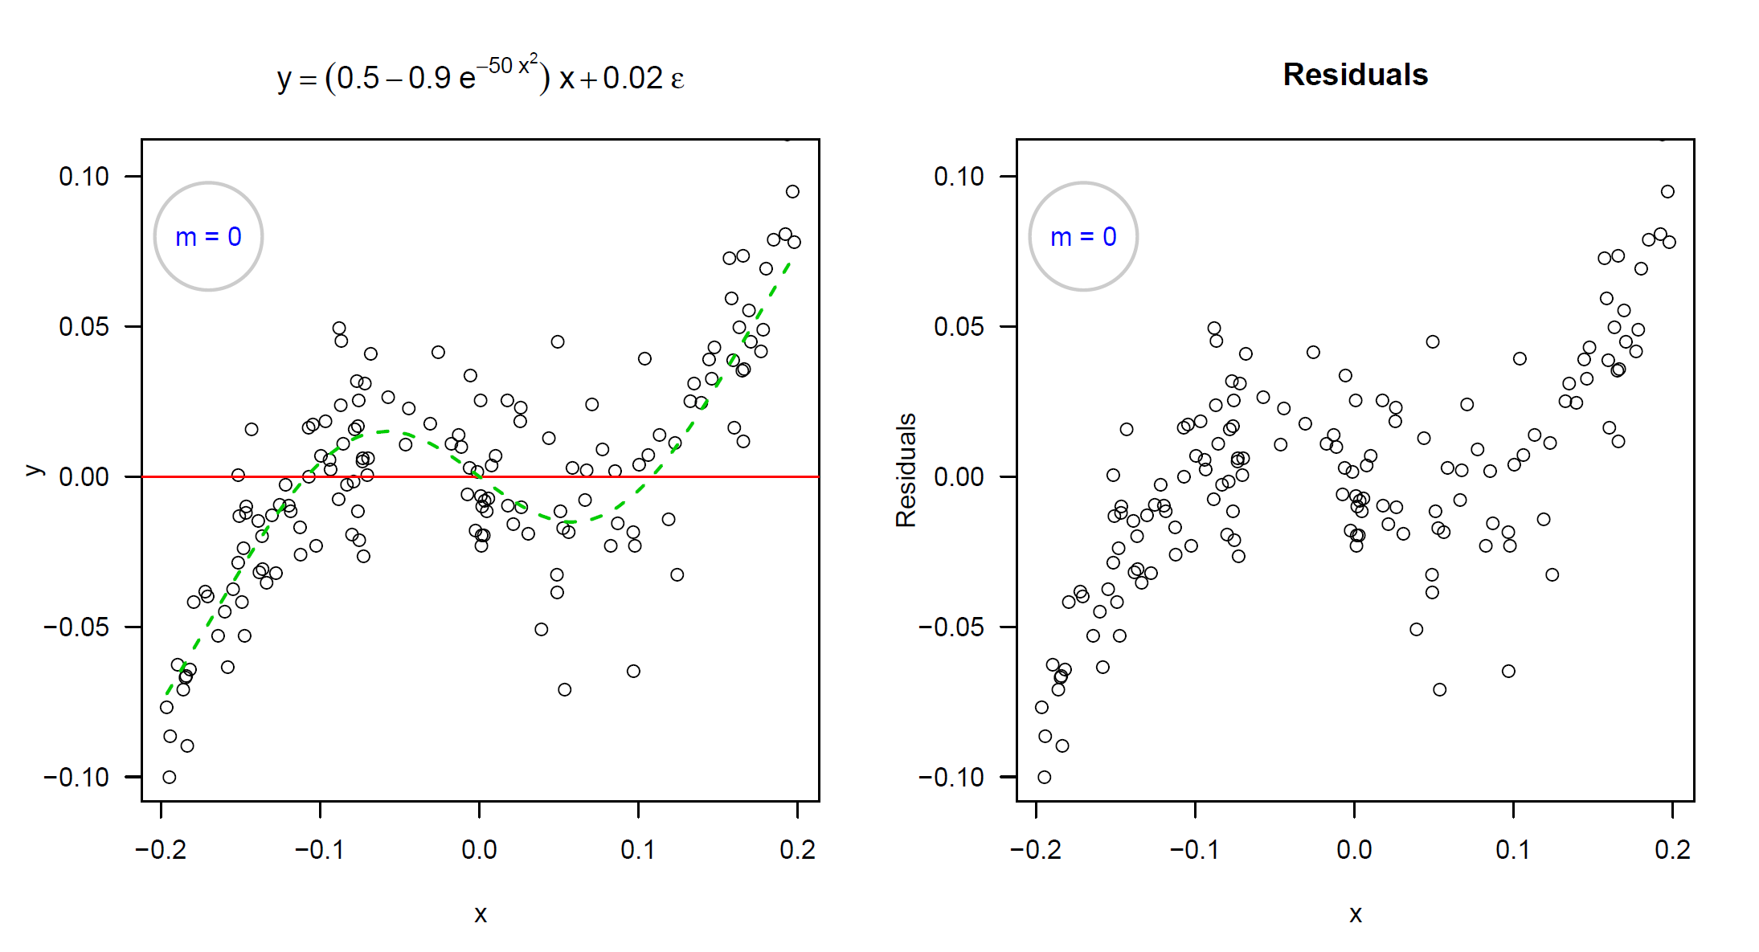
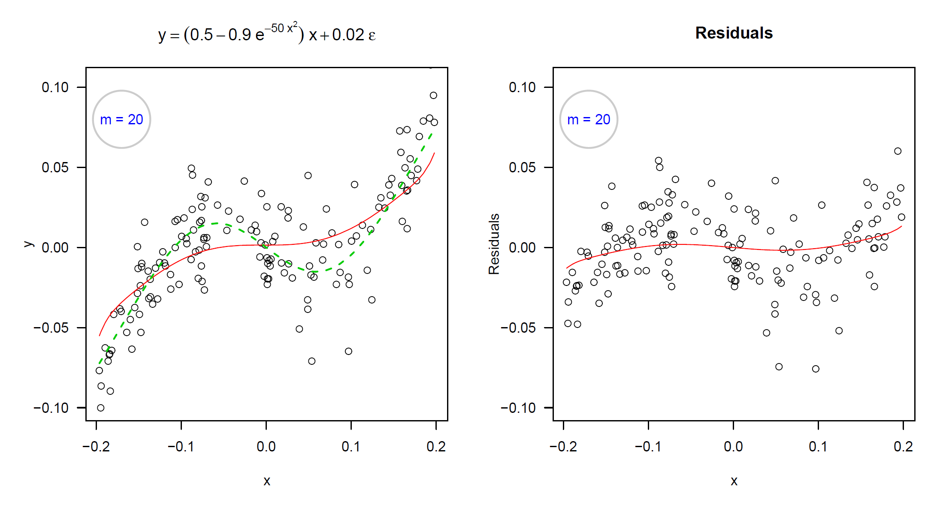
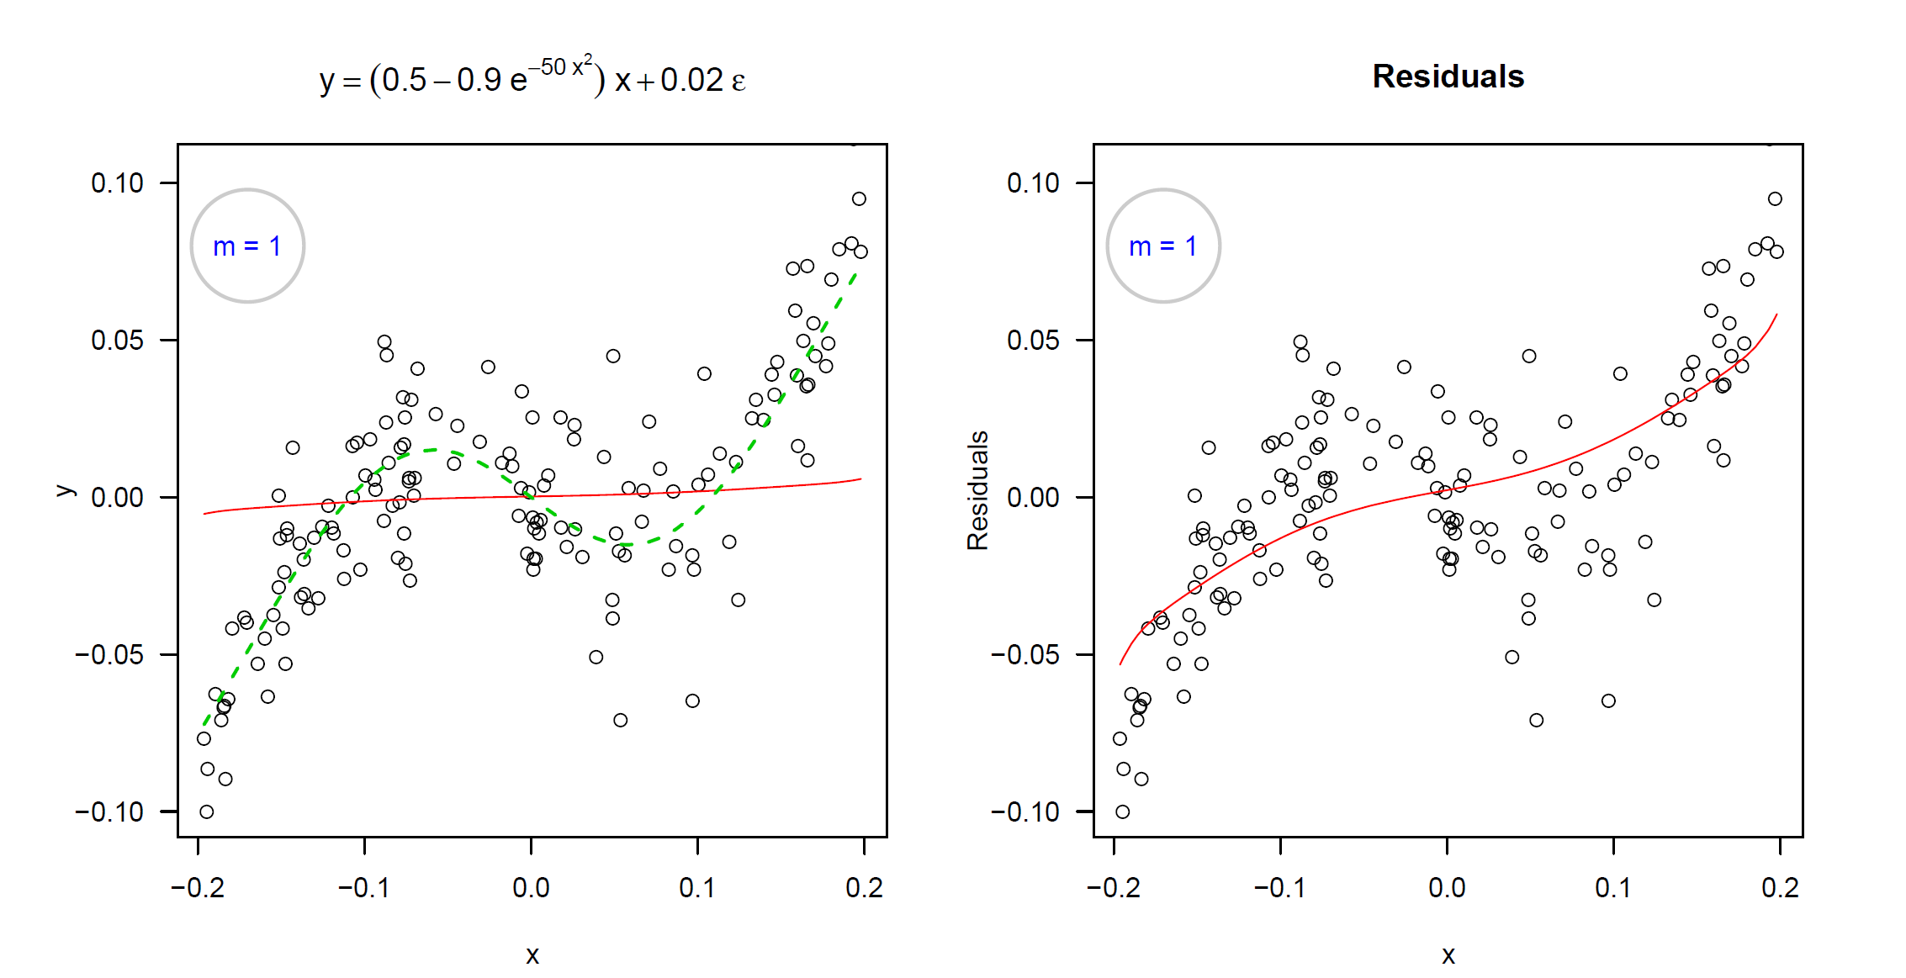
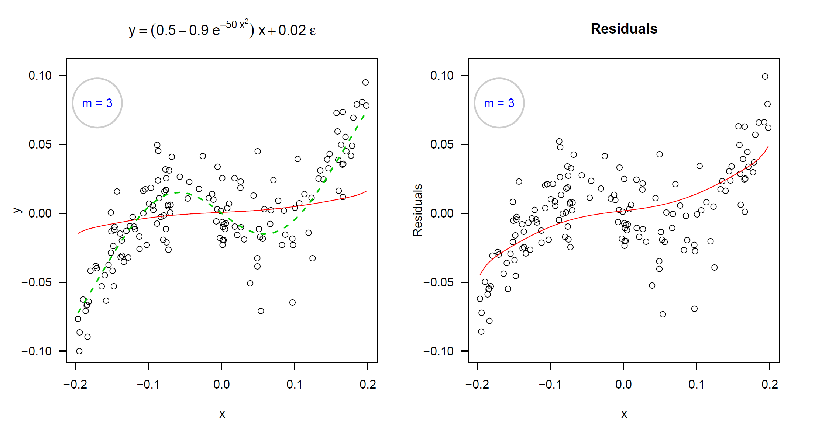
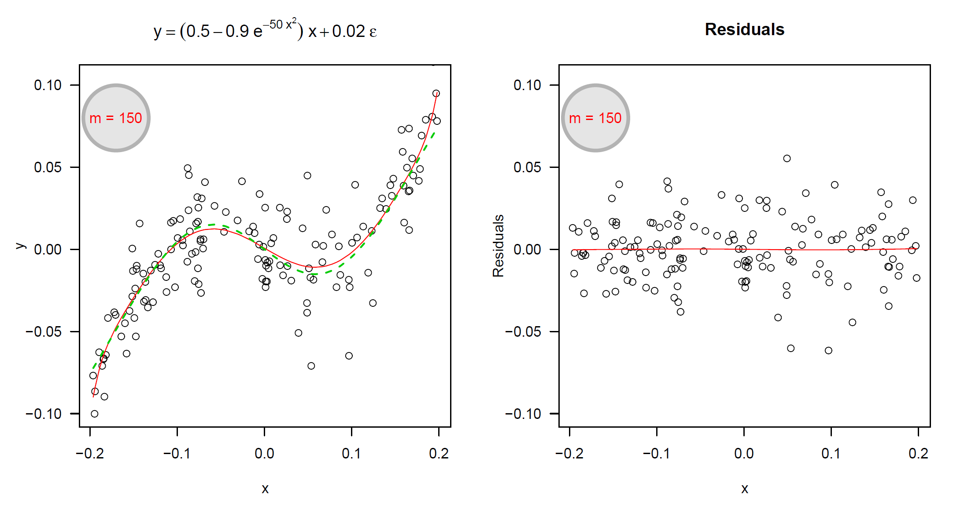

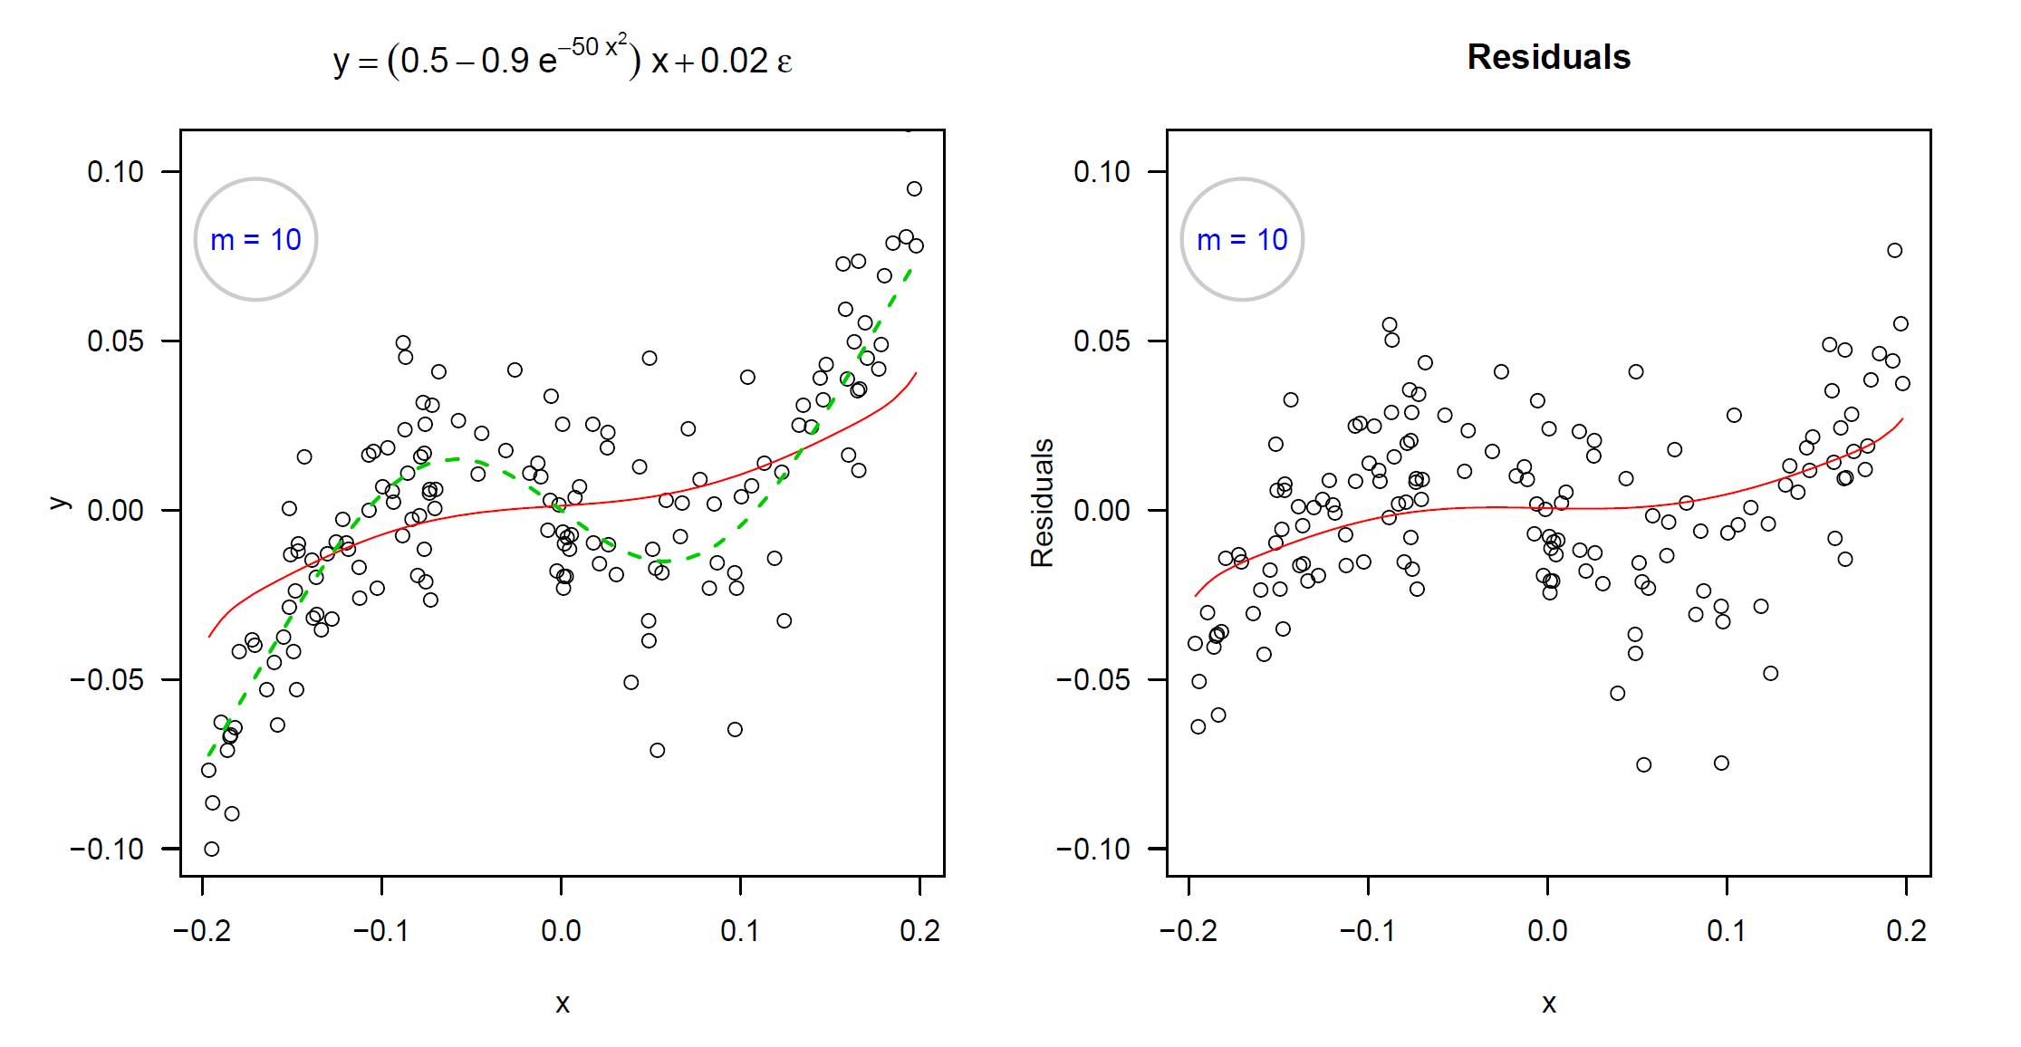
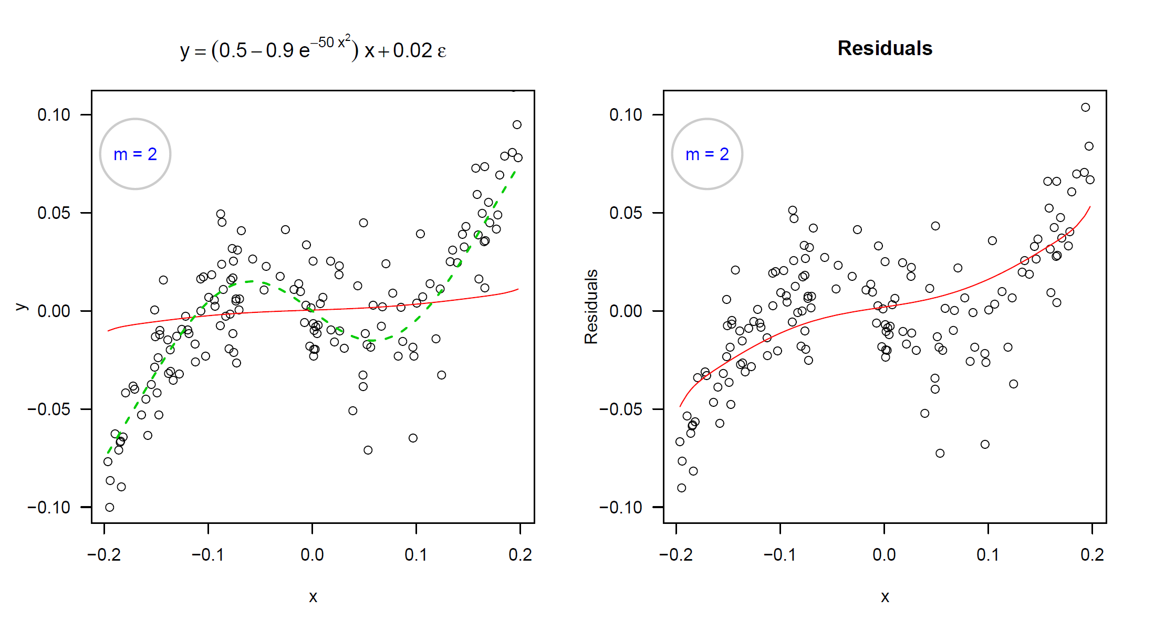
Example iteration – function approximation

Slide 23
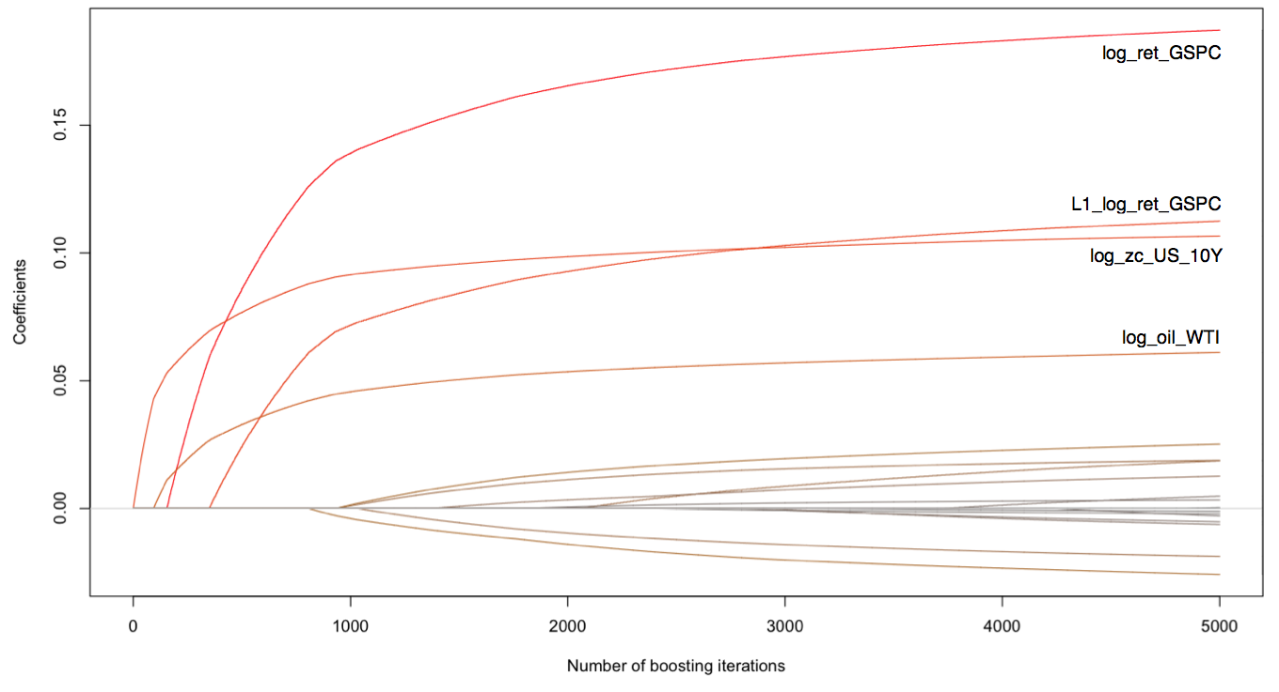
Evolution of coefficients
S&P500
Lagged S&P500
US Gov. bonds
Crude oil

Slide 24
Reminder of the datasets
∑
traditional_{small} 6
traditional_{large} 36
Traditional market data
small selection
everything
Sentiment data only
Aggregated
Individual
sentiment_{small} 22
sentiment_{large} 100
combined 142
Market + social media data
→ Correlation measures taken reduce datasets for final model

Slide 25
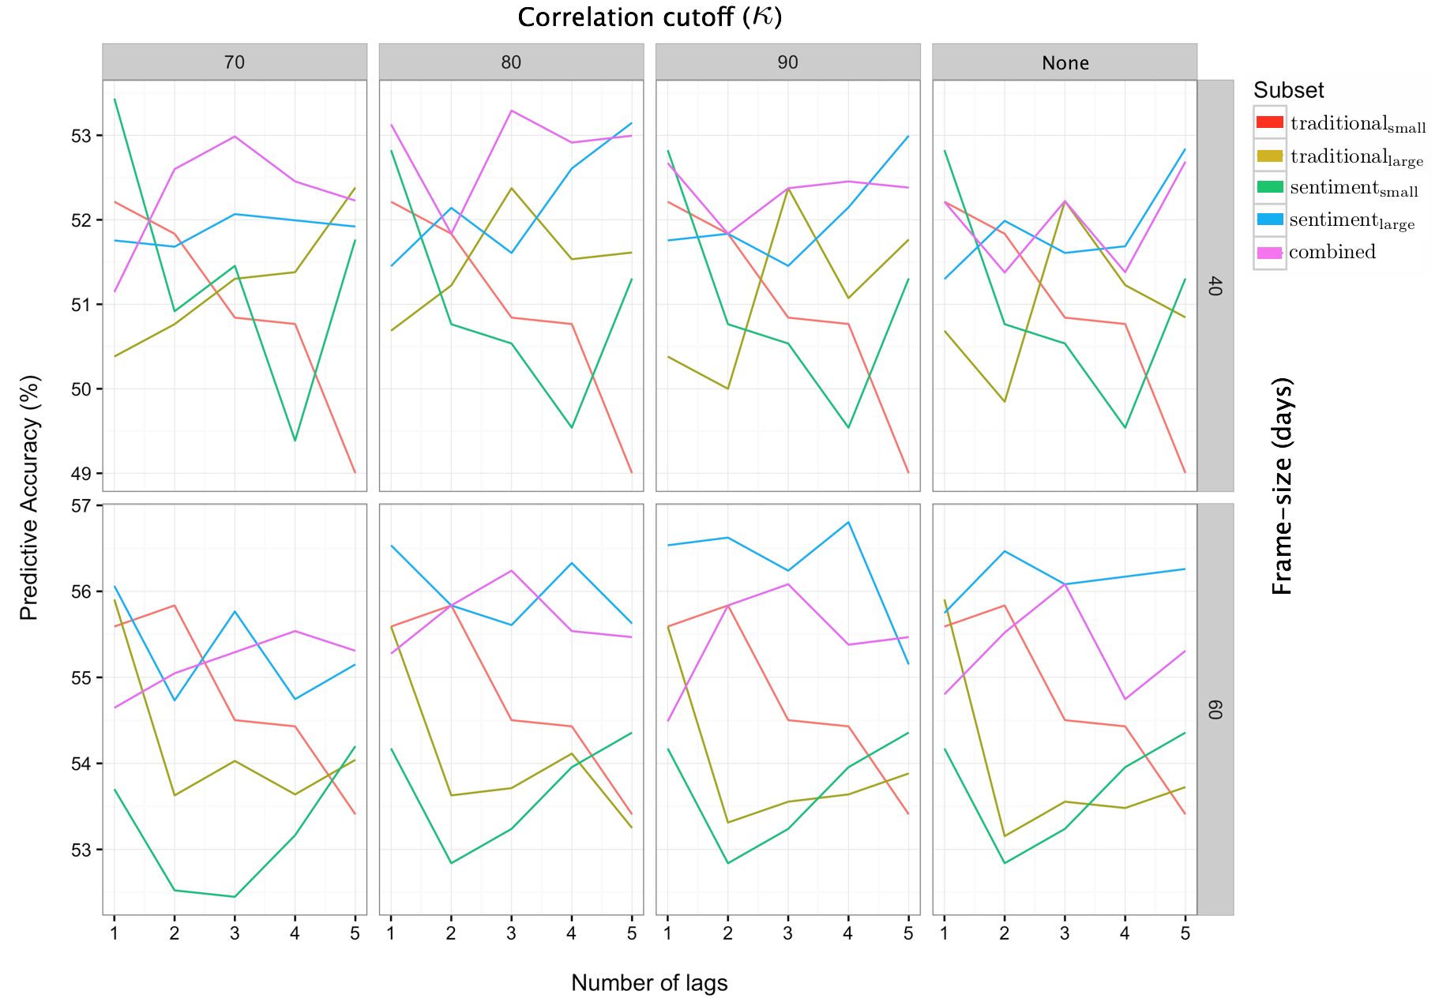
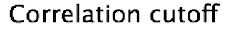
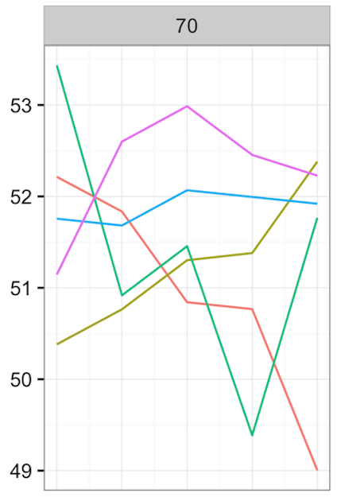
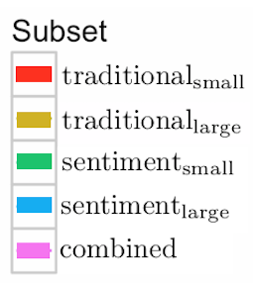
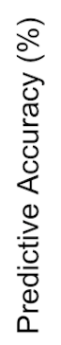
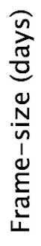
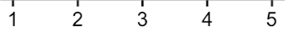
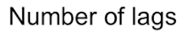
Results
Notes:
Explain the use of correlation cut-off and the frame size – draw on board?
200 results in one graph – can make a lot of comparisons, but main take away is that the blue and pink lines general dominate in all 8 plots!
Trad_small and sent_small even going below 50% in some cases
Larger frame size is better across the board
Not shown here, but errors are the same or smaller for the combined dataset. All about 5e-5.

Slide 26
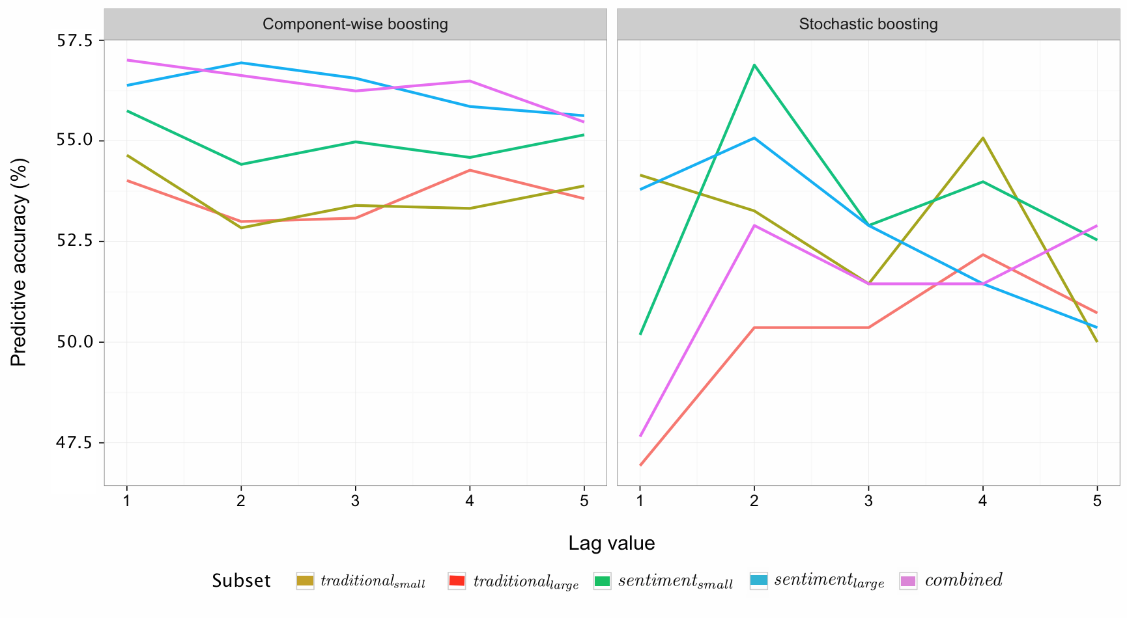
Stochastic Gradient Boosting - comparison
Notes:
Stochastic converges more quickly (less iterations)
Less likely to be overfit the data → should make better out-of-sample predictions
Removes some level of systematic
Still performs batch-gradient descent → no variable selection like component-wise boosting!

Slide 27
The Roadmap
Questions? Ideas for future work?
Obtain social media data
→ Twitter scraping
Perform NLP on every tweet
→ sentiment analysis
Predictive modelling
→ gradient boosting
Market data

Slide 28
The Roadmap - master
Obtain social media data
→ Twitter scraping
Perform NLP on every tweet
→ sentiment analysis
Predictive modelling
→ gradient boosting
Market data

